Slide 1

Airline Ticketing System
Group-3

Slide 2
Presented by
Guna Sai
Pardhavi Perepi
Ashwitha
Sai Vardhan
Meghana
Manikanta

Slide 3
Objective
To provide a reliable and efficient means of managing reservations, ticket sales, and passenger information for an airline.
To store all relevant data related to airline operations, such as flight schedules, seat availability, passenger data, and ticket pricing, in a centralized database
To ensure easy data retrieval and querying by creating tables for various types of data and setting up relationships between them.
To create a user interface for customers and airline staff to interact with the database, which may include a web-based application for flight search, seat availability, and ticket purchase.
To streamline airline operations by providing accurate and up-to-date information about flight schedules, seat availability, and other relevant data to staff and customers.

Slide 4
Introduction
The airline business is a highly competitive and continuously expanding industry that needs efficient and effective operations management systems.
An airline ticketing system is an essential component of any airline's operations, as it allows passengers to book flights and manage their travel plans.
Developing an airline ticketing system in DBMS (Database Management System) can bring significant advantages, such as increased efficiency, improved data management, better security, scalability, and better decision-making.
The use of a DBMS can help airlines to streamline the ticket booking process, manage large amounts of data more effectively, and provide valuable insights into customer behavior and preferences.
This can lead to higher customer satisfaction, increased revenue, and a competitive advantage in the marketplace.
In this context, developing an airline ticketing system in DBMS is a complex and challenging task that requires careful planning, design, and implementation, as well as ongoing maintenance and optimization to ensure a smooth user experience for passengers.

Slide 5
Tables
Customers
Flight
Cancellation
Luggage
Passengers
Bookings

Slide 6
Attributes
Customers
Customer_ID Varchar(20)
First_Name char(20)
Last_Name char(20)
EmailID Varchar(30)
Phone_Num int(10)
Flight
Flight_Code Varchar(20)
Company Varchar(20)
Arrival Varchar(20)
Departure Varchar(20)
Arrival_Time Datetime(fsp)
Departure_Time Datetime(fsp)
Total_Capacity Int(20)
Available_Seats Int(20)

Slide 7
Attributes
Cancellation
Cancellation_ID Varchar(20)
Passenger_ID Varchar(20)
Refund_type Varchar(20)
Flight_Code Varchar(20)
First_Name Varchar(20)
Last_Name Varchar(20)
Booking_ID Varchar(20)
Luggage
Luggage_ID Varchar(20)
Passenger_ID Varchar(20)
Booking_ID Varchar(20)
Cabin_Bags int(20)
Luggage_Bags int(20)

Slide 8
Attributes
Passangers
Passanger_ID Varchar(20)
Booking_ID Varchar(20)
First_Name char(20)
Last_Name Varchar(20)
Gender char(1)
Age tinyint
Bookings
Booking_ID varchar(20)
Customer_ID varchar(20)
Flight_code varchar(20)
Price Float(p)
Date_of_Travel Datetime(fsp)
Booking_Date Datetime(fsp)

Slide 9
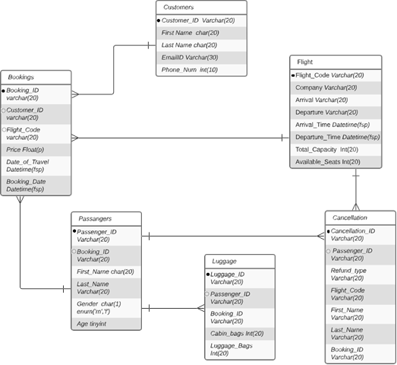
ER Diagram

Slide 10
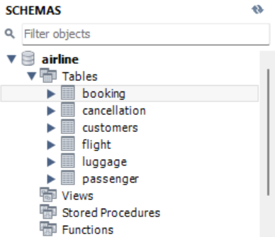
Query1(Creation of Tables)
1) Create all 6 tables with specified constraints and datatypes using the third normal form.

Slide 11
Query-1
2.) Queries used for creating the 6 tables is specified in the below text file.
CREATE TABLE CUSTOMERS (
Customer_ID VARCHAR(30) PRIMARY KEY,
First_Name char(20),
Last_name char(20),
Email_ID VARCHAR(40),
Phone_num int
);

Slide 12
Query-1
CREATE TABLE FLIGHT(
Flight_code VARCHAR(20) PRIMARY KEY,
Company VARCHAR(20),
Arrival varchar(20),
departure varchar(20),
Arrival_time Datetime,
Departure_time Datetime,
Total_Capacity int(20),
Available_seats int(20)
);
Create table Booking(
Booking_ID varchar(20) PRIMARY KEY,
Customer_ID VARCHAR(20),
Flight_code varchar(20),
Price float,
Date_of_Travel Datetime,
Booking_date Datetime,
FOREIGN KEY (Customer_id) REFERENCES CUSTOMERS(Customer_id)
);

Slide 13
Query-1
CREATE TABLE Passenger(
Passenger_ID VARCHAR(20) PRIMARY KEY,
Booking_ID VARCHAR(20),
First_Name char(20),
Last_name char(20),
Gender char(1),
Age tinyint,
FOREIGN KEY (Booking_ID) REFERENCES Booking(Booking_ID)
);
Create table Luggage(
Luggage_ID VARCHAR(20) PRIMARY KEY,
Passenger_ID VARCHAR(20),
Booking_ID VARCHAR(20),
Cabin_bags int(20),
Luggage_bags int(20),
FOREIGN KEY (Passenger_ID) REFERENCES Passenger(Passenger_ID)
);

Slide 14
Query-1
CREATE TABLE Cancellation(
Cancellation_id varchar(20),
Passenger_ID Varchar(20),
refund_type varchar(20),
flight_code varchar(20),
first_name char(20),
Last_name varchar(20),
Booking_id varchar(20),
FOREIGN KEY (Passenger_ID) REFERENCES Passenger(Passenger_ID)
);

Slide 15
Query-2(Insertion of values)
2) Following the 3rd (BCDNF) normal form to insert the data. Attached screenshots below which shows the data in the workbench and attached insertion queries for those tables which are used.
--- For booking table
INSERT INTO booking (Booking_ID, Customer_ID, Flight_code, Price, Date_of_Travel, Booking_date)
VALUES
('BID01', 'C97642', 'FDNYL', '1500.5', '2023-05-01 12:00:00', '2023-04-23 10:00:00'),
('BID02', 'C67543', 'FUSFT', '2250', '2023-06-10 23:00:00', '2023-04-25 16:00:00'),
('BID03', 'C43674', 'FAACP', '1800', '2023-07-15 09:00:00', '2023-04-26 14:00:00'),
('BID04', 'C97642', 'FKAYK', '1600', '2023-08-05 11:00:00', '2023-07-15 12:50:00'),
('BID05', 'C98143', 'FANJT', '450', '2023-08-15 03:00:00', '2023-07-07 00:00:00'),
('BID06', 'C86754', 'FDNYL', '1400', '2023-09-05 09:40:00', '2023-08-21 00:00:00'),
('BID07', 'C90990', 'FQASW', '2300', '2023-09-10 07:00:00', '2023-08-26 00:00:00'),
('BID08', 'C97642', 'FKAYK', '1600', '2023-08-05 11:00:00', '2023-07-15 12:50:00');

Slide 16
Query-2
--- for Customers table
INSERT INTO customers (Customer_ID, First_Name, Last_name, Email_ID, Phone_num)
VALUES
('C00887', 'Avery', 'Carter', 'averycarter@email.com', '34567802'),
('C01076', 'Julia', 'Davis', 'juliadavis@email.com', '12346790'),
('C01099', 'Peter', 'Anderson', 'peteranderson@email.com', '23568901'),
('C08941', 'Lucy', 'Wilson', 'lucywilson@email.com', '34569012'),
('C08978', 'Tom', 'Moore', 'tommoore@email.com', '45689023'),
('C11990', 'Evelyn', 'Baker', 'evelynbaker@email.com', '12346780'),
('C16176', 'Elijah', 'Scott', 'elijahscott@email.com', '90134578'),
('C16692', 'Nathan', 'Thomas', 'nathanthomas@email.com', '67812345'),
('C17178', 'Olivia', 'Taylor', 'oliviataylor@email.com', '56790234'),
('C17524', 'Jacob', 'Clark', 'jacobclark@email.com', '89012457'),
('C18532', 'juvva', 'satish', 'sarawilliams@email.com', '45678013'),
('C18854', 'Sophia', 'Roberts', 'sophiaroberts@email.com', '78903456'),
('C20222', 'Noah', 'Baker', 'noahbaker@email.com', '12356790'),
('C21345', 'Ethan', 'Green', 'ethangreen@email.com', '34679012'),
('C21987', 'Emma', 'Hill', 'emmahill@email.com', '23456901'),
('C26531', 'Ava', 'Hall', 'avahall@email.com', '45678903'),

Slide 17
Query-2
('C42314', 'Mason', 'Wright', 'masonwright@email.com', '78923456'),
('C42318', 'Mia', 'Young', 'miayoung@email.com', '67890125'),
('C43674', 'Pardhavi', 'prerepi', 'Pardhaviprerepi@hotmail.com', '55533424'),
('C55668', 'Logan', 'Nelson', 'logannelson@email.com', '23456891'),
('C66861', 'Emily', 'Jones', 'emilyjones@email.com', '67890145'),
('C67543', 'Ghana', 'Koniki', 'GhanaKoniki@yahoo.com', '987543210'),
('C68133', 'Eric', 'Brown', 'ericbrown@email.com', '90123678'),
('C76521', 'David', 'Lee', 'davidlee@email.com', '78013456'),
('C76541', 'Mike', 'Johnson', 'mikejohnson@email.com', '56789134'),
('C86754', 'Liam', 'Allen', 'liamallen@email.com', '56780234'),
('C88754', 'Harper', 'King', 'harperking@email.com', '89012457'),
('C90990', 'Isabella', 'Lewis', 'isabellalewis@email.com', '90235678'),
('C97642', 'Guna', 'Koniki', 'GunaKoniki@gmail.com','829372082');

Slide 18
Query-2
--For flight table
INSERT INTO flight (flight_code, company, arrival, departure, arrival_time, departure_time, total_capacity, available_seats) VALUES
('FAACP', 'American Airlines', 'Chicago', 'Paris', '2023-07-15 09:00:00', '2023-07-15 02:00:00', 400, 350),
('FANJT', 'Air Canada', 'NewJersey', 'Toronto', '2023-08-15 03:00:00', '2021-08-15 05:00:00', 300, 250),
('FDNYL', 'Delta', 'New York', 'London', '2023-05-01 12:00:00', '2023-05-01 07:00:00', 300, 250),
('FKAYK', 'Korean Air', 'NewYork', 'Korea', '2023-08-05 11:00:00', '2021-08-05 05:30:00', 350, 300),
('FQASW', 'Qantas Airways', 'Washington', 'Sydney', '2020-09-10 07:00:00', '2023-09-10 08:30:00', 300, 250),
('FSCZ', 'Swiss', 'California', 'Zurich', '2023-09-05 09:40:00', '2021-09-05 08:00:00', 350, 300),
('FUSFT', 'United', 'San Francisco', 'Tokyo', '2023-06-10 23:00:00', '2023-06-10 18:00:00', 200, 150);

Slide 19
Query-2
--FOr Luggage table
INSERT INTO Luggage (Luggage_ID, Passenger_ID, Booking_ID, Cabin_bags, Luggage_bags)
VALUES
('LKG2774', 'PSN02774', 'BID05', '0', '1'),
('LKG3828', 'PSN03828', 'BID06', '2', '1'),
('LKG4161', 'PSN04161', 'BID03', '0', '1'),
('LKG4367', 'PSN04367', 'BID01', '1', '2'),
('LKG5431', 'PSN05431', 'BID02', '2', '3'),
('LKG6473', 'PSN06473', 'BID04', '3', '1'),
('LKG8427', 'PSN08427', 'BID07', '2', '0');
--For Passegner table
INSERT INTO passengers (Passenger_ID, Booking_ID, First_Name, Last_name, Gender, Age)
VALUES
('PSN02774', 'BID05', 'Meghana', 'Mamidi', 'F', '21'),
('PSN03828', 'BID06', 'Sai', 'Reddy', 'M', '26'),
('PSN04161', 'BID03', 'Pardhavi', 'prerepi', 'F', '45'),
('PSN04367', 'BID01', 'Guna', 'Koniki', 'M', '35'),
('PSN05431', 'BID02', 'Ghana', 'Koniki', 'F', '28'),
('PSN06473', 'BID04', 'Ashwitha', 'Vengalareddy', 'F', '22'),
('PSN08427', 'BID07', 'Karthik', 'Chiluku', 'M', '22');

Slide 20
Query-2
--For cancellation table
INSERT INTO Cancellation (Cancellation_id, Passenger_ID, refund_type, flight_code, first_name, Last_name, Booking_id)
VALUES
('C01', 'PSN04367', 'Full Refund', 'FDNYL', 'Guna', 'Koniki', 'BID01'),
('C02', 'PSN05431', 'Partial Refund', 'FUSFT', 'Ghana', 'Koniki', 'BID02'),
('C03', 'PSN04161', 'No Refund', 'FAACP', 'Pardhavi', 'prerepi', 'BID03'),
('C04', 'PSN06473', 'Full Refund', 'FKANYK', 'Ashwitha', 'Vengalareddy', 'BID04'),
('C05', 'PSN02774', 'Full Refund', 'FACNJT', 'Meghana', 'Mamidi', 'BID05'),
('C06', 'PSN03828', 'Full Refund', 'FSCZ', 'Sai', 'Reddy', 'BID06'),
('C07', 'PSN08427', 'Full Refund', 'FQAWS', 'Karthik', 'Chiluku', 'BID07');

Slide 21
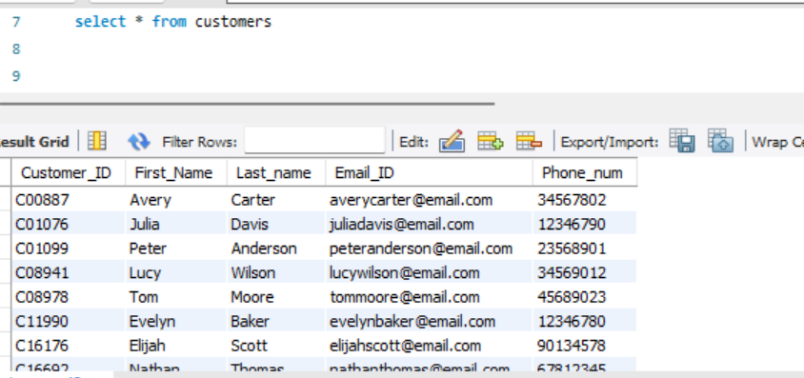
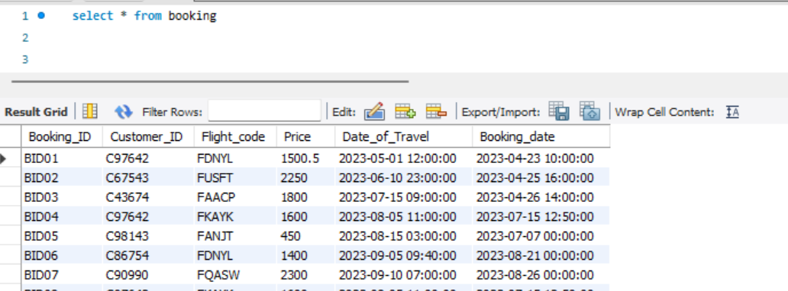
Query-3(Selection statements)
Customers Table (Main table):
Booking Table:

Slide 22
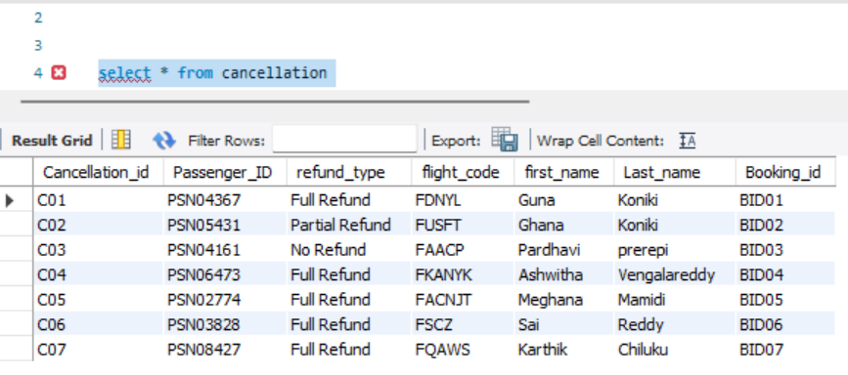
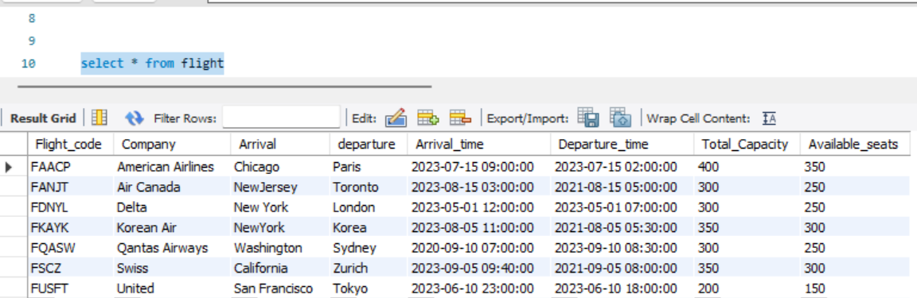
Query-3
Cancellation Table:
Flight Table:

Slide 23
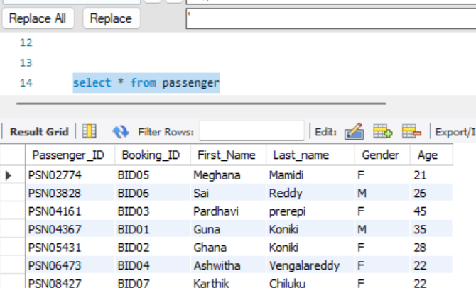
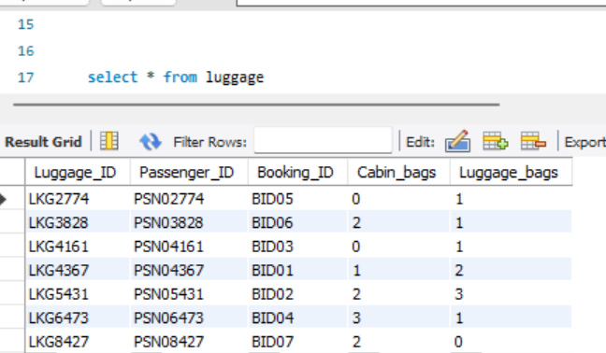
Query-3
Passenger Table:
Luggage Table:

Slide 24
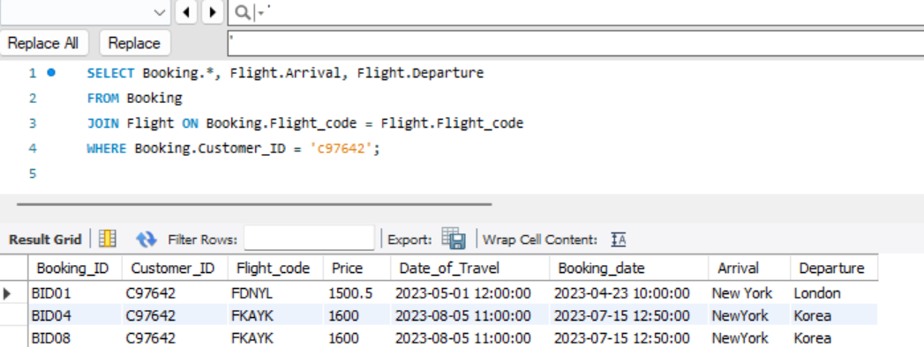
Query-3
Used the following three queries to extract the data which follows BCDNF using Keys.
1) SELECT Booking.*, Flight.Arrival, Flight.Departure
FROM Booking
JOIN Flight ON Booking.Flight_code = Flight.Flight_code
WHERE Booking.Customer_ID = 'c97642’;

Slide 25
Query-3
2) SELECT Flight.Flight_code, Flight.Total_Capacity - COUNT(Booking.Booking_ID) AS Available_seats
FROM Flight
LEFT JOIN Booking ON Flight.Flight_code = Booking.Flight_code
GROUP BY Flight.Flight_code;
OUTPUT:

Slide 26
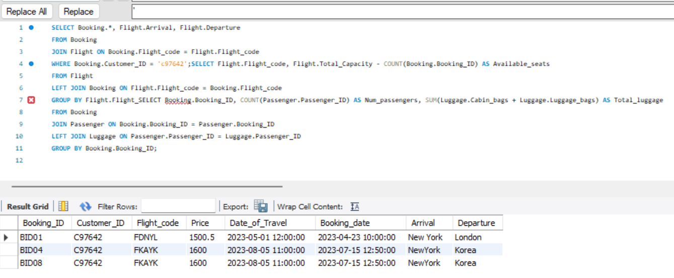
Query-3
3) SELECT Booking.Booking_ID, COUNT(Passenger.Passenger_ID) AS Num_passengers, SUM(Luggage.Cabin_bags + Luggage.Luggage_bags) AS Total_luggage
FROM Booking
JOIN Passenger ON Booking.Booking_ID = Passenger.Booking_ID
LEFT JOIN Luggage ON Passenger.Passenger_ID = Luggage.Passenger_ID
GROUP BY Booking.Booking_ID;
OUTPUT:

Slide 27
Challenges
Data modeling: Creating an efficient data model for an airline ticketing system can be difficult due to the enormous quantity of complicated data involved, such as flight schedules, seat availability, price, passenger information, and payment details. A badly constructed data model can lead to performance concerns, inconsistencies in data, and decreased scalability.
Security: Airline ticketing systems handle sensitive information such as passenger details, payment information, and flight schedules, making them a target for cybercriminals. Ensuring the security of the database, implementing proper access controls, and encrypting sensitive data is critical to prevent unauthorized access and data breaches.

Slide 28
Advantages
Faster and more efficient booking process: The use of a DBMS in the development of an airline ticketing system can streamline the booking process, making it faster and more efficient. This can lead to higher customer satisfaction and increased revenue for the airline.
Good security: It provides robust security features such as access controls, encryption, and data backups, to protect sensitive information such as passenger details and payment information.

Slide 29


